Slide 1
New Thames Bridge
Linking Nine Elms to Pimlico
Notes:
Welcome.
This short presentation aims to show you all the processes taken to developing a final design proposal for the New Thames Bridge, linking Nine Elms to Pimlico as part of the Battersea Power Station redevelopment in London.

Slide 2
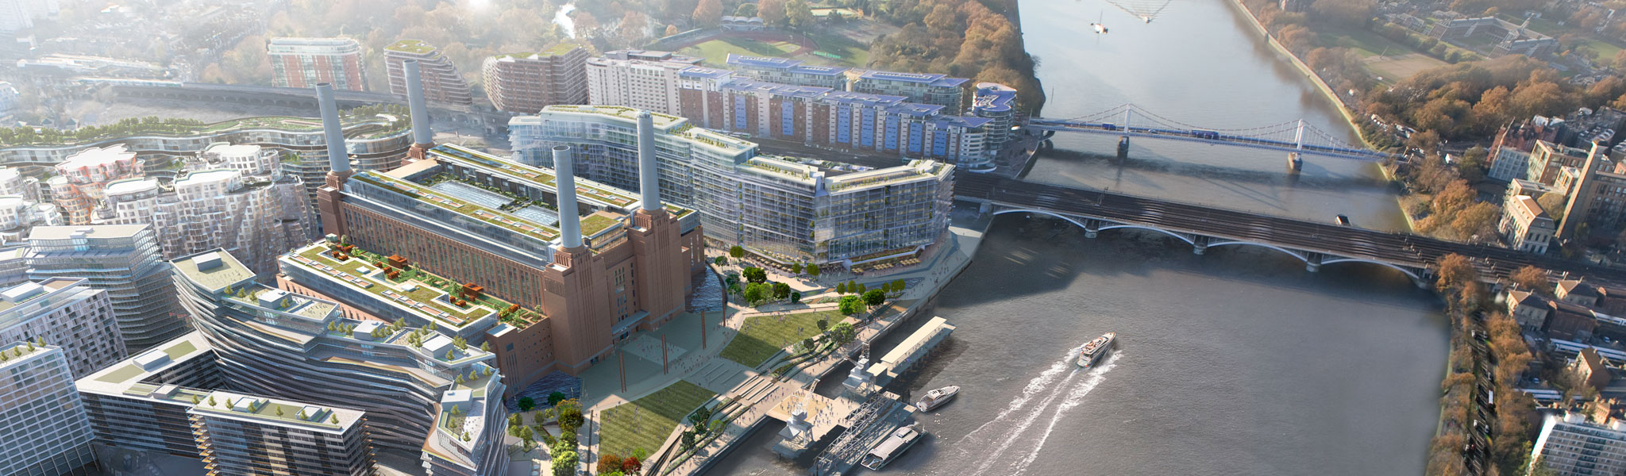
The brief
As part of the Battersea Power Station redevelopment a new foot bridge is too be built to encourage cross river foot traffic and improve access to the redevelopment.
The bridge must provide ample capacity for both pedestrians and cyclists both currently and in the future with the expected rise in use from the redevelopment site.
Image taken from Battersea Power Station website: https://batterseapowerstation.co.uk/#!/portal
Notes:
The brief given on Monday was this: As part of the redevelopment of the Battersea Power Station site a new footbridge has been suggested to encourage cross river foot and cycle traffic to and from the redeveloped site. The bridge must provide amply capacity for the large number of people likely to use this new route and should be convenient for commuters, tourists and walkers to access and use. One of the main focuses was linking the site with the public transport at Pimlico such as the London Underground. The bridge would also allow Thames Path users to cross the river without needing to use a road bridge.

Slide 3
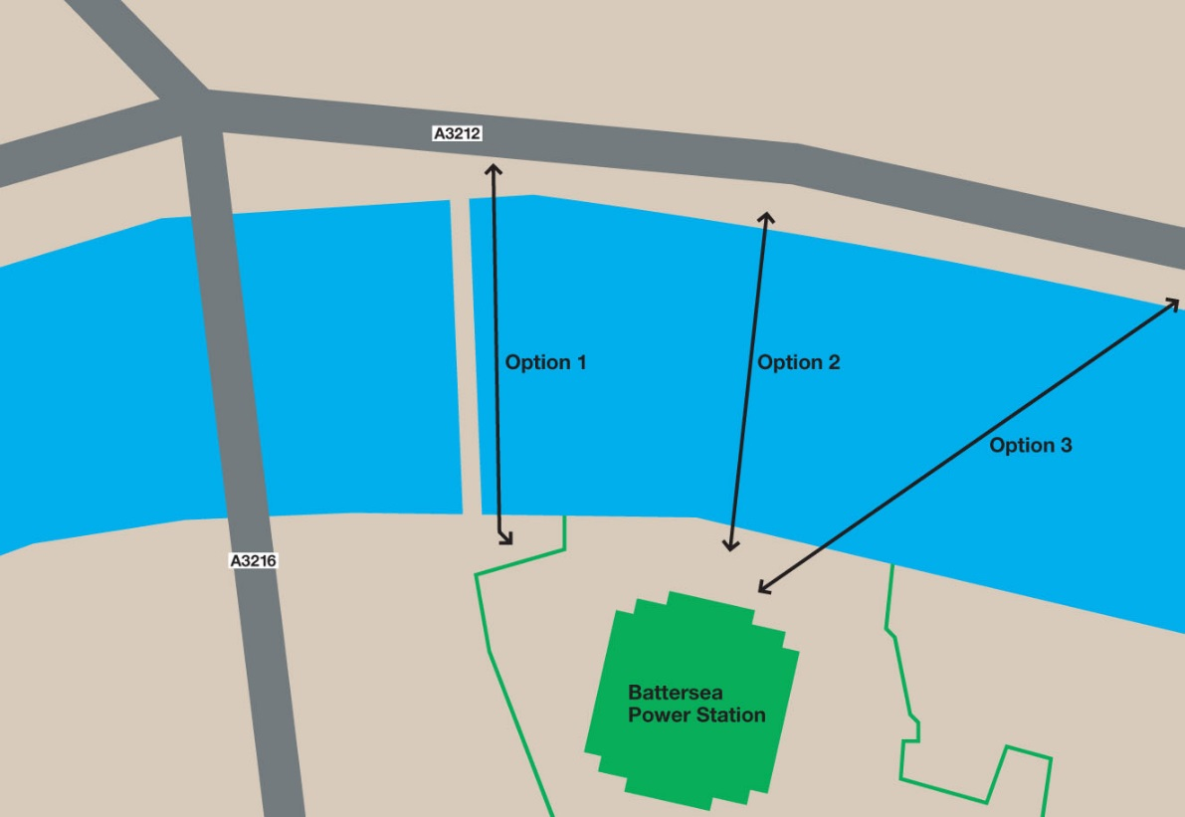
Bridge alignment
The bridge alignment is a vital part of the design both for usability and for gaining public support and planning permission.
Three options were presented as shown and have advantages and disadvantages that require careful consideration.
Notes:
Three options were given during the initial planning permission stage and are as follows: Option 1 to add a footbridge onto the side of the existing railway bridge. Option 2 to create a new bridge from the front of the power station to the opposite bank. Option 3 to create a new bridge from the corner of the power station spanning diagonally across the river. All three options have their own unique advantages and disadvantages that required careful consideration before committing to a final alignment.

Slide 4

Option 1
Attaching the new footbridge to the existing railway bridge.
Advantages:
  Minimal visual impact as no new bridge is required.
  New deck could gain most of the support needed from the existing railway bridge structure.
Disadvantages:
  This alignment would not provide convenient access for users coming from the local Pimlico railway station.
  Also this alignment has minimal area to provide access at either end of the bridge, possibly producing bottle necking.
  Finally the disruption required to the railway bridge would be difficult to justify.
Notes:
Advantages:
Minimal visual impact as no new bridge is required.
New deck could gain most of the support needed from the existing railway bridge structure.
Disadvantages:
This alignment would not provide convenient access for users coming from the local Pimlico railway station.
Also this alignment has minimal area to provide access at either end of the bridge, possibly producing bottle necking.
Finally the disruption required to the railway bridge would be difficult to justify.

Slide 5
Option 2
Building a new bridge directly in front of the power station.
Advantages:
  This alignment would be the shortest option for a bridge reducing costs.
  This option would also be easy to fit into the South bank side and provide good access at the power station end.
Disadvantages:
  The area for landing the bridge on the North bank is very limited and would be difficult to accommodate due to the very narrow pavement.
  Also access from Pimlico Station is still not very convenient with this alignment.
  Finally this alignment comes very close to one of the working piers on the South Bank potentially causing unnecessary problems with the operation of this pier.
Notes:
Advantages:
This alignment would be the shortest option for a bridge reducing costs.
This option would also be easy to fit into the South bank side and provide good access at the power station end.
Disadvantages:
The area for landing the bridge on the North bank is very limited and would be difficult to accommodate due to the very narrow pavement.
Also access from Pimlico Station is still not very convenient with this alignment.
Finally this alignment comes very close to one of the working piers on the South Bank potentially causing unnecessary problems with the operation of this pier.

Slide 6
Option 3
Building a new bridge from Battersea Power Station at an angle across the river in the direction of Pimlico station.
Advantages:
  There is more space for landing the bridge on both banks, especially on the North bank where space is problematic.
  This alignment provides convenient access for users traveling from Pimlico railway station to the Nine Elms site.
Disadvantages:
  Option 3 requires the longest bridge of all the options, increasing the potential construction costs.
  Also this alignment would make access from the West side of the North bank less convenient than other options.
Notes:
Advantages:
There is more space for landing the bridge on both banks, especially on the North bank where space is problematic.
This alignment provides convenient access for users traveling from Pimlico railway station to the Nine Elms site.
Disadvantages:
Option 3 requires the longest bridge of all the options, increasing the potential construction costs.
Also this alignment would make access from the West side of the North bank less convenient than other options.

Slide 7
Choice of alignment
The final choice of alignment was Option 3. Despite the increased length and thus increased cost, this alignment has most space for construction of the bridge on the North bank and also provides the best access for people coming from Pimlico station direction.
Notes:
The final choice of alignment was Option 3. Despite the increased length and thus increased cost, this alignment has most space for construction of the bridge on the North bank and also provides the best access for people coming from Pimlico station direction.

Slide 8
Bridge designs
Initial ideas were sketched and then pitched against each other looking at the advantages and disadvantages of each design. This then allowed the designs to be narrowed down to a shortlist of two designs shown below.
Notes:
Starting with unchosen design:
As you can see this design is a very slender concept with a thin profile. This design would be very minimalistic and would aim to highlight the power station site itself rather that draw attention to the new bridge.
The other design stands out more with it's cable stayed deck structure and was chosen as the preferred design for the location subject to minor alterations.

Slide 9
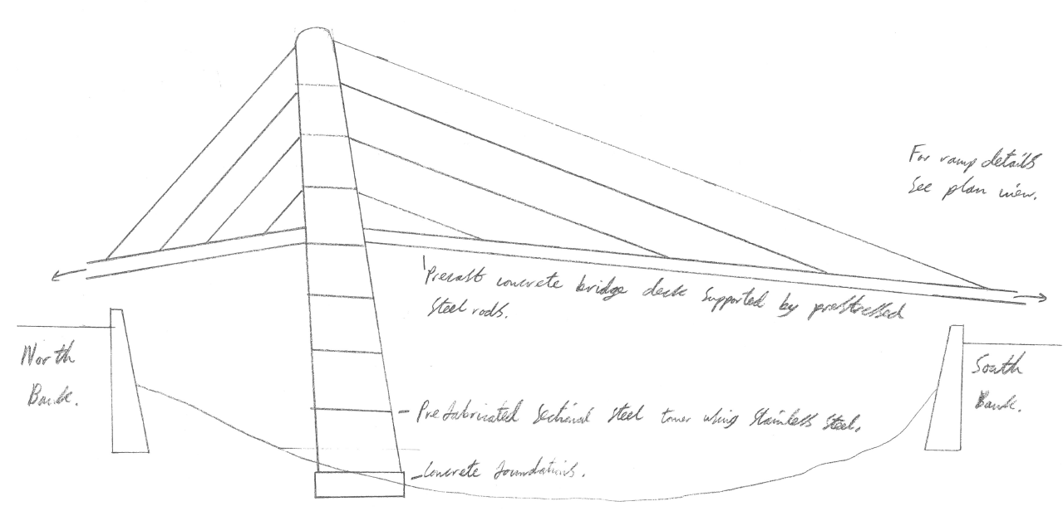
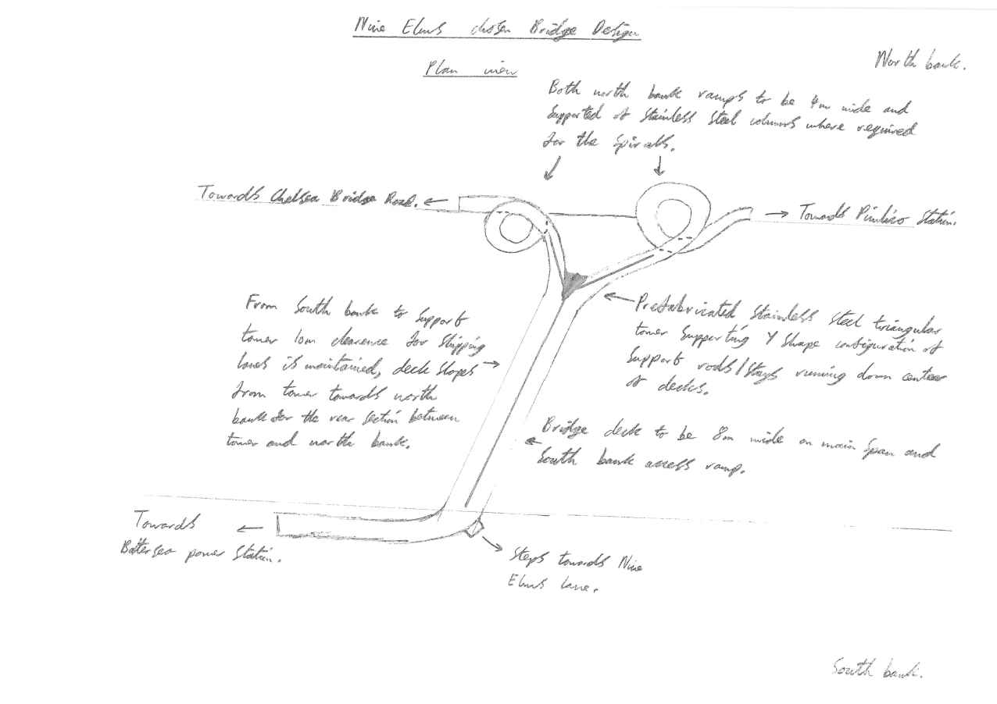
The chosen design
The chosen design concept underwent changes to allow it to be more suitable to the purpose in hand. A couple of quick sketches were drawn up to show the revised design.
Notes:
The chosen concept is intended to be constructed mainly from prefabricated sections that could be brought to site using the river and then lifted into place. This allows minimal disruption to the local residents and also helps solve some of the access problems faced on the North Bank. The bridge is designed to split into a Y shape near the North bank to allow equal access from both East and West. As can be seen the North bank access ramps form spirals allowing the access ramps to stay closer and more localised to the bridge due to land constraints. These spirals would be supported of the bank itself and not the bridge. On the South bank this split was not necessary as a high percentage of users will be heading to the redeveloped power station site to the West of the bridge. For those who wish to go East on the South Bank a set of steps are provided at the curve in the access ramp.

Slide 10
Any questions please?
Notes:
Thank-you for listening. Now you have seen the final design proposed do any of you have any questions I may be able to help answer? I have also prepared a preliminary construction sequence if you would like to take a look.

